Slide 1
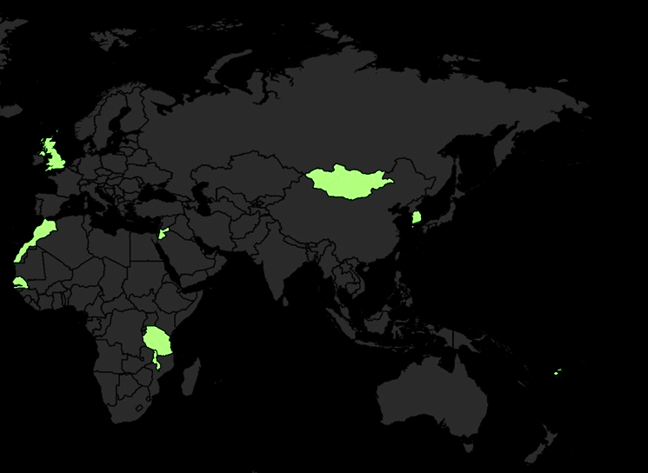

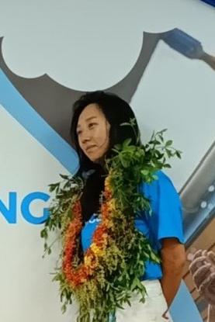



KIM JUNGHWA
Study program: Social Development Practice (MSc) and Cultural Anthropology (BA)
Year of study: Graduate
Motto for life: πάθει μάθος (pathei-mathos) - wisdom arises from (personal) suffering and that personal experience is the genesis of true learning
Hobbies: Freediving, Travelling, Journalling, Yoga
Your expectations from the summer school: Rediscover both the joy and struggles that come with learning
Where I have lived and worked
Karlsruhe
31 August to 11 September 2026

